Slide 1



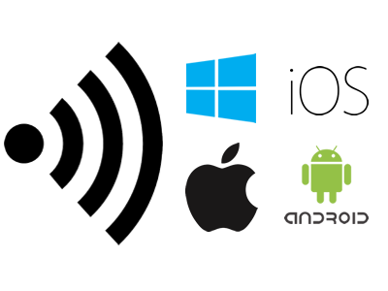
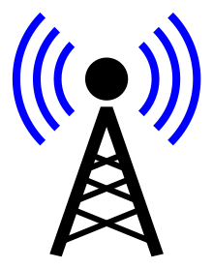
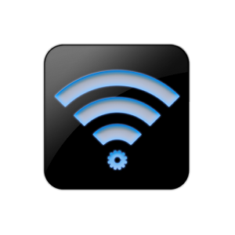

Wireless Computing
Wireless Computing or Cloud Computing : It is an efficient technology which uses radio and wireless signals spectrum to communicate and store data or giving commands to form a list of functions that can be executed at a particular time. In this type of technology data is transmitted through wireless server on an particular host. Also Data is transmitted across the connected devices in an Binary form that is 0 and 1. This is also used in controlling an DJI Drone.There are many-many uses of wireless computing that can't be defined in a single sentence.

Slide 2
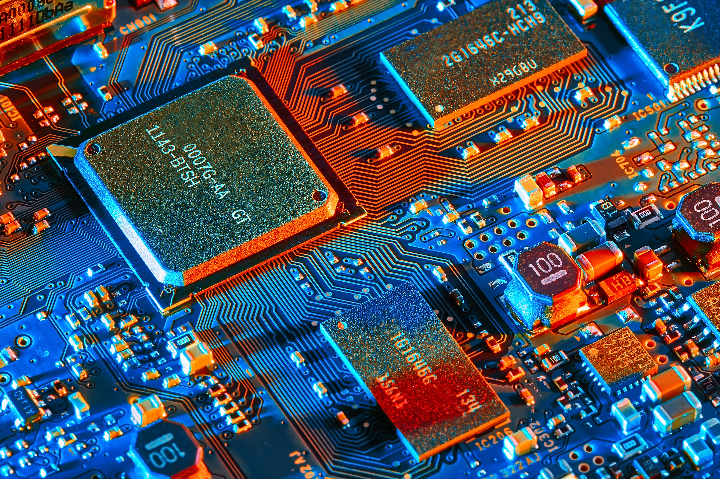


Trends in Wireless Computing
® Computer Programming.
® Handy wireless pocket Devices.
® Cloud wireless Computing.
® Drone Functioning Power to Scientific Field.
® Enhancement in Wireless Data transmitting.
® Connectivity Improvements.
® Monetization of content across the world .

Slide 3

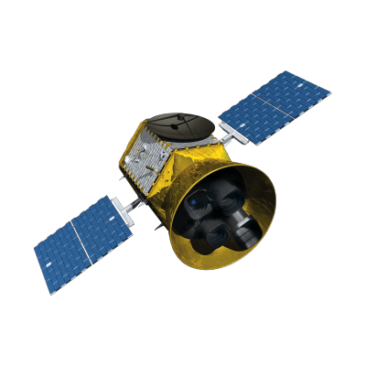
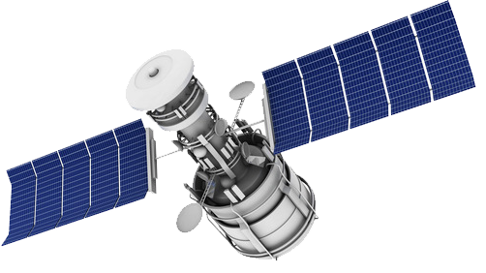
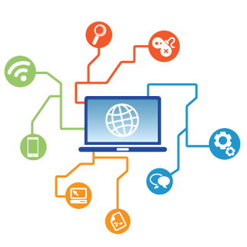
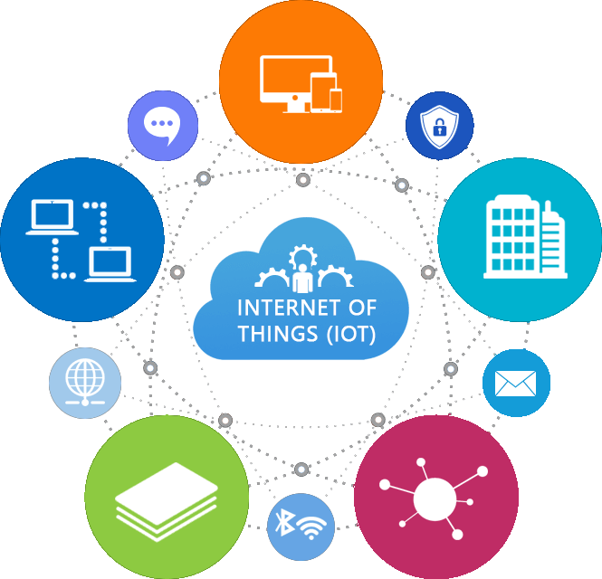
Any Data,any Time,Any Place
Wireless and Radio Network
The Cloud computing has given advantage to people to access their data with the applications with improved speed and better manageability and less maintenance. Users are able to share their data between them as the network is connected and common to all. Thus the place of work has been virtualized with the aid of cloud computing.

Slide 4
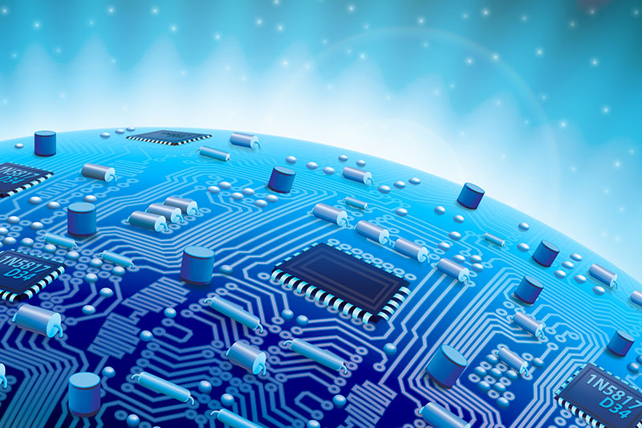

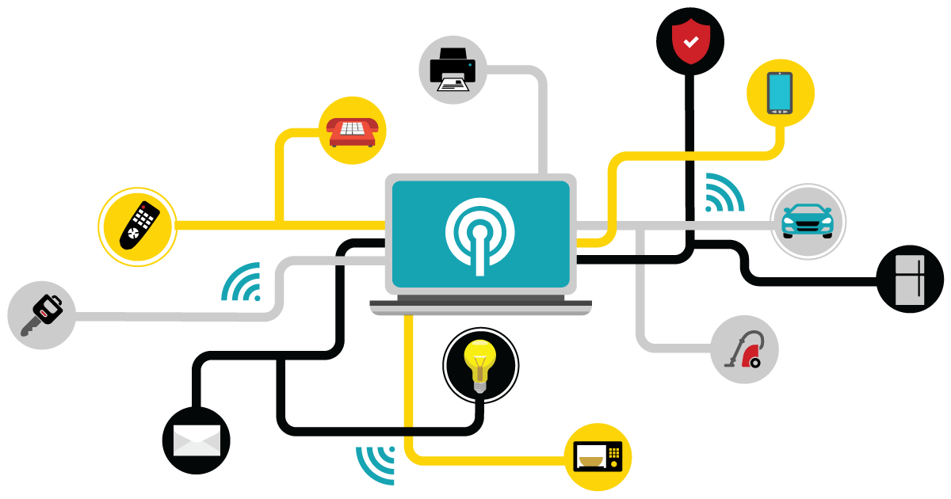

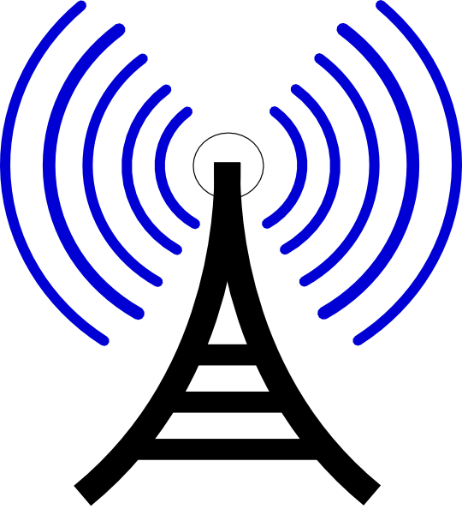
Full Range of Wireless Technologies
Zigbee is a wireless communication technology for short-range, low-power digital radio communications. Relative to WiFi and Bluetooth, Zigbee uses very little power and a low data transfer rate. This results in a wireless mesh network, which can cover large areas.

Slide 5

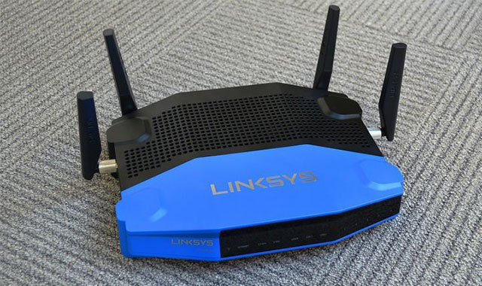

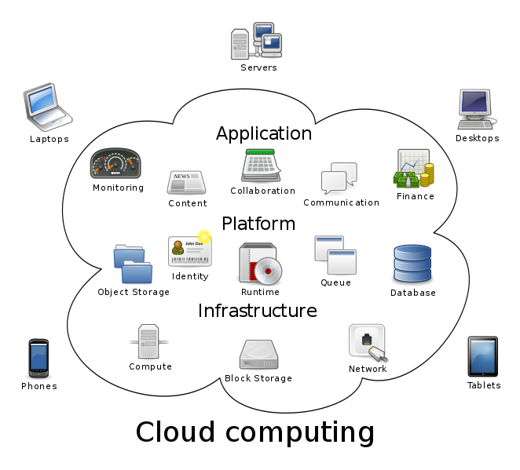
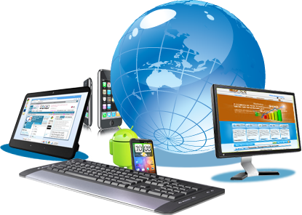

Handset evolution & Convergence
The ongoing deployment of the fourth generation (4G) of wireless mobile systems has prompted some telecommunication companies to consider further development towards fifth generation (5G) technologies and services. Since the appearance of the first generation (1G) system in 1981, new generations have emerged approximately every 10 years. Wireless communication generations typically refer to non-backwards-compatible standards following requirements specified by the International Telecommunication Union-Radiocommunication Sector (ITU-R). Examples of these specifications are International Mobile Telecommunications 2000 (IMT-2000) for 3G and IMT-Advanced for 4G.

Slide 6


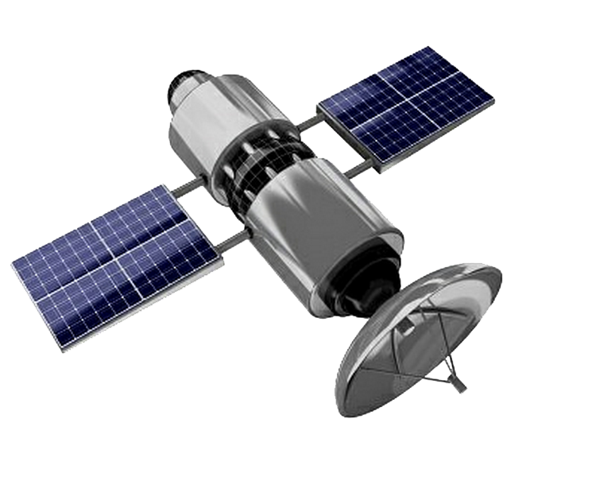
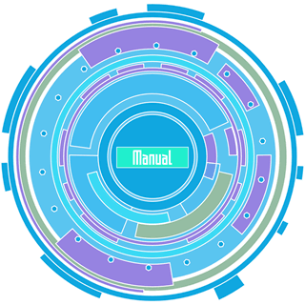
A Vision of the future

